Slide 1

WELCOME!!!
2° (and final)
TUTORIAL

Slide 2


Slide 3






Slide 4


Slide 5

MODAL VERBS

Slide 6
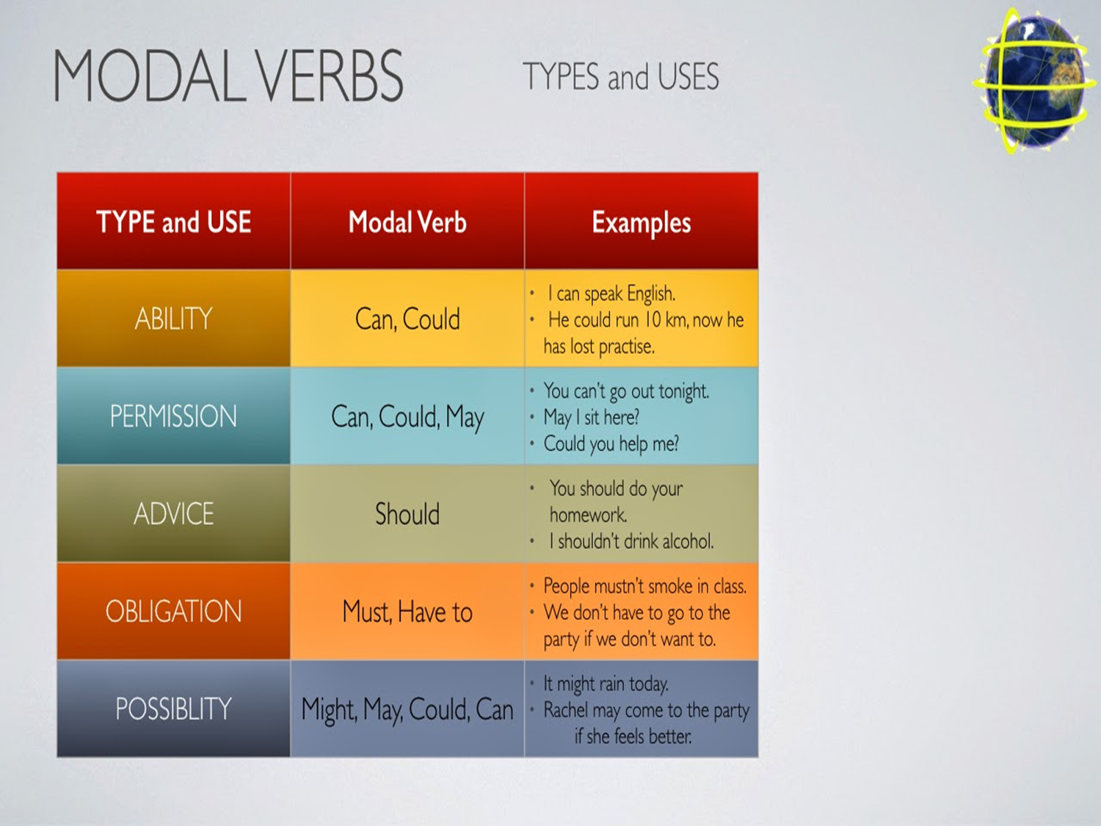

Slide 7
What are modal verbs?
Modals (also called modal verbs, modal auxiliary verbs, modal auxiliaries) are special verbs which behave irregularly in English.
They are different from normal verbs like "work, play, visit..." They give additional information about the function of the main verb that follows it. They have a great variety of communicative functions.
Here are some characteristics of modal verbs:
• They never change their form. You can't add "s", "ed", "ing"...
• They are always followed by an infinitive without "to" (e.i. the bare infinitive.)
• They are used to indicate modality allow speakers to express certainty, possibility, willingness, obligation, necessity, ability

Slide 8

http://www.myenglishpages.com/site_php_files/grammar-exercise-modals-meaning.php

Slide 9
What is the difference between shall and will?
Shall is not used often in modern English especially in American English. In fact, shall and will have the same meaning and are used to refer to the simple future. They are use as follows:
• will is used with all persons
I, you, he, she, it, we, they will go there
• shall is used with the first person singular and plural
I, we shall go
• The short form of will and shall is 'll
I, you, he, she, it, we, they will or 'll call you

Slide 10
Uses of shall
It should be noted that shall is often used to make suggestions, offers or ask for advice. It is used in questions as follows:
Shall we stay or go out?
Shall we dance?
Shall I get his phone number if I meet him?
What shall I do to get rid of my acne?

Slide 11
As said above shall is used with first person singular and plural (I and we.) But there is a very special use of shall with other persons to make a promise, command or threat as noted below:
• You shall not get in! (Command)
• You shall pay for it. (Threat)
• You shall get your money back soon. (Promise)
In American English shall is mainly used in formal or legal documents:
• You shall abide by the law.
• There shall be no trespassing on this property.
• Students shall not enter this room.

Slide 12

http://www.myenglishpages.com/site_php_files/grammar-exercise-modals.php

Slide 13




Slide 14
Instruction:
You WILL have 10 minutes to write a short text (around 50 to 60 words) in which you MUST include 5 modal verbs and 5 uses of modal verbs. PS: The text SHOULD be as logical as possible.
PS 2: You CAN use your current situation at the university, or invent a short history about a topic of your choice.
PS 3: You MIGTH want to use the next example so you can have an idea of what do you have to write
PS 4: You SHALL share your text with the class.

Slide 15
Example:
“It is the end of November, and I have to go to every class, or I might fail the class due to attendance. I remember that I could stay all night long studying and go to classes the day after, but not anymore. I´ve been feeling very tired lately so my friend told me that I should go to the doctor ASAP. I found my teacher and I ask him: May I leave class early today?
He answered: Yes you may.”

Slide 16


Slide 17


