Slide 1


MDD 1
CONTEXTUAL FACTORS
Luis Gutiérrez Oviedo

Slide 2
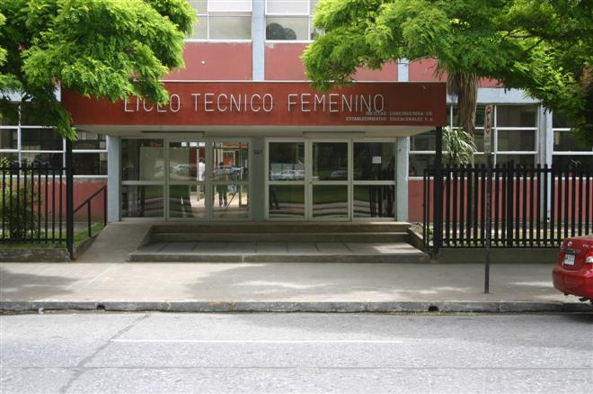
Liceo Técnico Femenino de Concepción
Subsidized Institution
Located in Victor Lamas #567

Slide 3

Liceo Técnico Femenino de Concepción
Administrated with public and private funds.
Benefits: food (JUNAEB) and Transportation (TNE) scholarships.
68 staff members
745 students from 9th to 12th grade.

Slide 4
General Facilities
Library
Close and open gym
2 computer labs
3 nursing rooms
2 conference rooms

Slide 5
Specialties/Major facilities
Atención de Párvulos
Atención de Enfermería mención Adulto Mayor
2 labs
Servicios de Hotelería
1 lab
Gastronomía con menciones Pastelería y Repostería.
2 labs

Slide 6
Classrooms facilities
Big locker
Computer and gadgets
Data projector
Whiteboard
Electric air heater

Slide 7
Class group characteristics
3 groups from 9th grade.
3 groups from 10th grade.
Average of 25 students.
No special needs observed
Low English level in general.

Slide 8
Reflections
Classroom facilities and equipment:
Acceptable equipment.
Allow the implementation of all four skills.
No internet connection LAN OR WIFI
Class group characteristics:
Childish Ss VS more mature Ss
Cellphone issues
Aware of any type of trending.
Students characteristics.
Motivated Ss from 10th grade.
Good student from 9th grade with a bad English base.

